Slide 1
Sportsman Mechanical CDR
12/6

Slide 2

Agenda
What Is Our Robot?
Chassis
Powertrain
Weapon
Concerns
Next Steps
Q&A

Slide 3

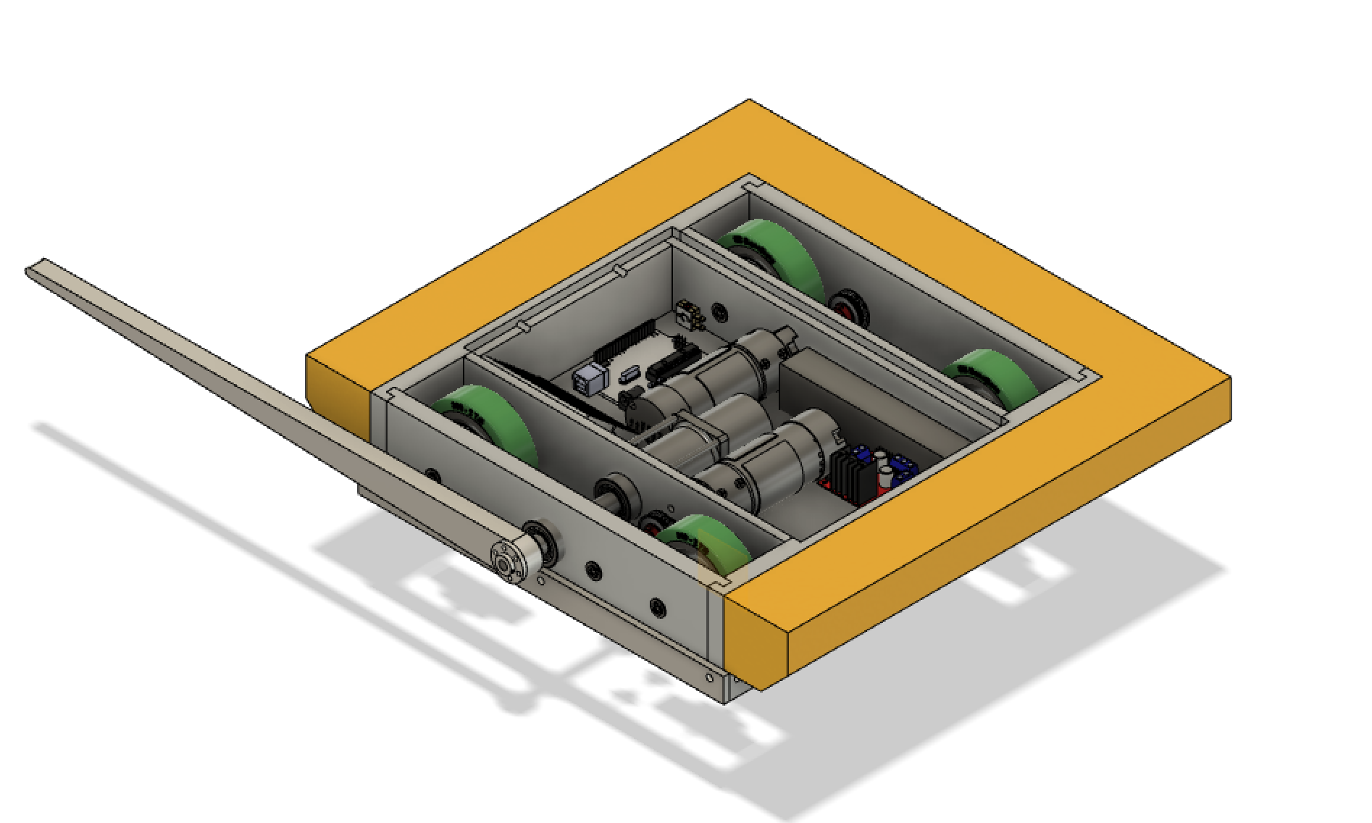
Lance

Slide 4
What Is Our Robot?
Sportsman Mechanical CDR
Lance is a two motor, 4 wheel drive flipper
Features:
HDPE chassis with foam ablatives
Long, aluminum flipper
4 wheel indirect drive
Optimized for Firmware Accessibility and autonomous capabilities

Slide 5
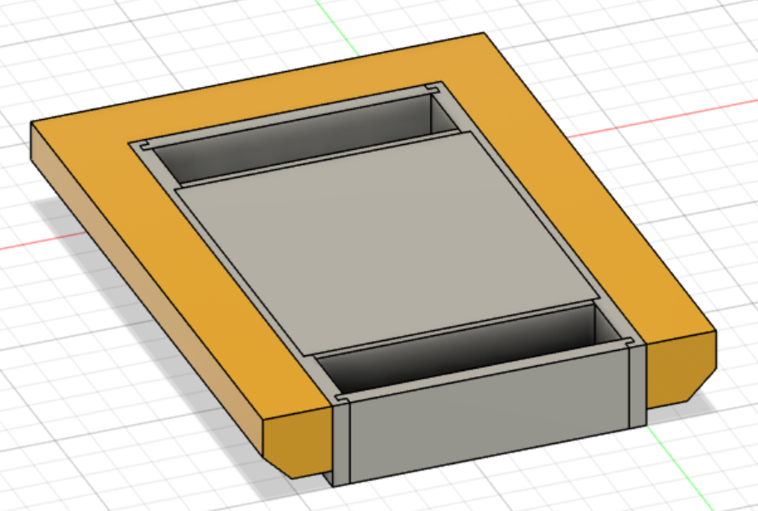
Chassis
Subsystems
Materials
HDPE internal structure = less dense than metal and good impact toughness
Foam Bumpers = ablative armor to protect against high-kinetic energy instantaneous attacks
Manufacturability
HDPE structure=mill
Foam=scissors, glue
Connections
Puzzle fits for strength without using screws
(high stress concentration)
Foam glued to chassis wall

Slide 6
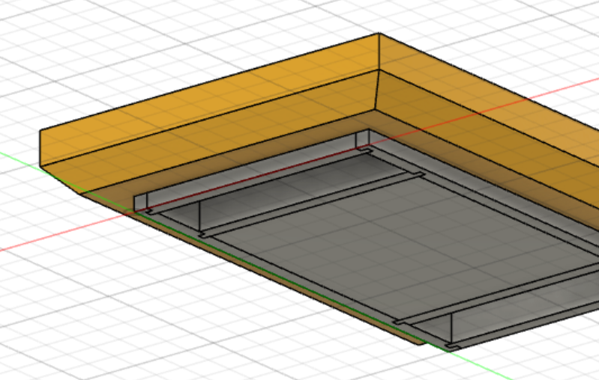
Chassis
Subsystems
Design
Thick HDPE walls (high impact toughness) with puzzle fits to avoid fracturing
Foam chamfered inwards to save weight and to reduce effectiveness of flippers
Shape - wider than it is deep to fit internal components, manufacturability
Open top wheels - no plate on top to save weight, predict little to no impact in area
Bumpers on three sides to protect non-weapon sides
Weight: 5-5.5 lbs
Price: ~$100

Slide 7
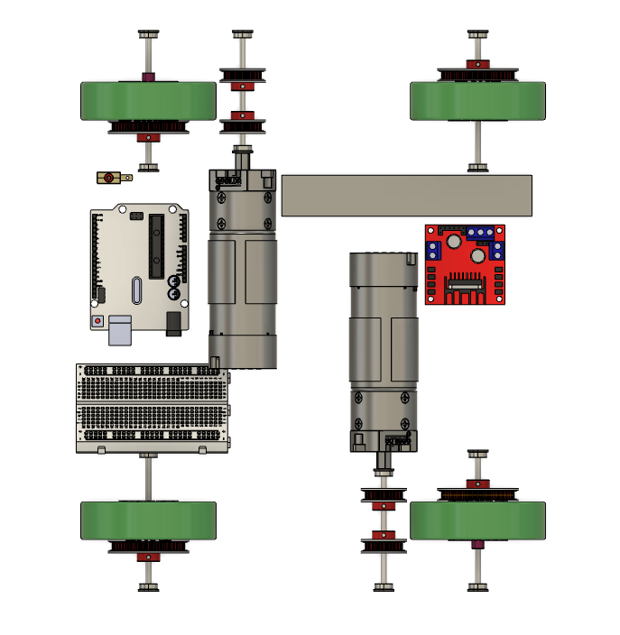
Powertrain
Subsystems
Final design:
4 wheels with indirect drive
2:1 pulley ratio to fit weapon between belts
From calculations:
angular velocity of wheels required → 752 rpm
torque needed → .51 Nm
with 2:1 pulley ratio, this means motor must have at least 1500 rpm and .25 Nm of torque
total weight → 4.5-5 lbs
Price: $350
Notes:
brun

Slide 8
Powertrain
Subsystems
Fingertech 22 and 42T pulleys
2:1 ratio
< the 3” diameter of wheels
many options for belt sizes
5203 Series Yellow Jacket Planetary Gear Motor
fits specs → 1600 rpm, 12V
stall torque .53 Nm → 2x the necessary torque of .26 Nm
motor and pulley axle connected by machined threading axle
ball bearings in walls holding wheel axles
Notes:
micheele

Slide 9
Powertrain
Subsystems
BaneBots 2 ⅞ ” wheels
fit our calculations for a ~ 3” wheel
have used BaneBots wheels in the past
3000 mAh Lipo Battery
calculations say we need 9000 mAh at stall torque, very hard to find a battery with this that is light enough
3000 mAh is fine for what we need, won’t always be running at stall torque
We will only be manufacturing the axles and motor axle
Firmware will be controlling drive motors with an ESC thru Arduino bluetooth module
Notes:
molyl

Slide 10
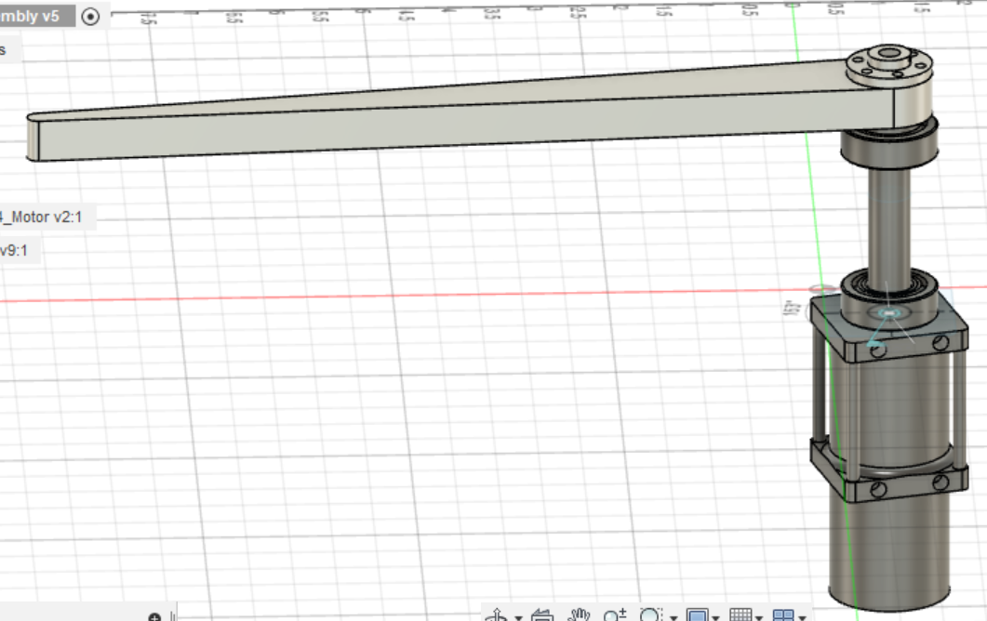
Weapon
Subsystems
Materials
Flipper=Aluminum 6061 (stock) Strong, light, and slightly flexible
Rod=High-strength steel - Heavy but very strong
Manufacturability
Flipper = Mill + Band saw (water jet if too hard to manufacture)
Shaft = Bandsaw
Hub = Mill
Spacer, Motor, Bearings, Screws = purchased
Connections
Flipper to shaft = Hub
Rod to motor = replacing original shaft
No need for flexible torque coupling plus no products that meet our specifications (must go through powertrain pulleys)

Slide 11
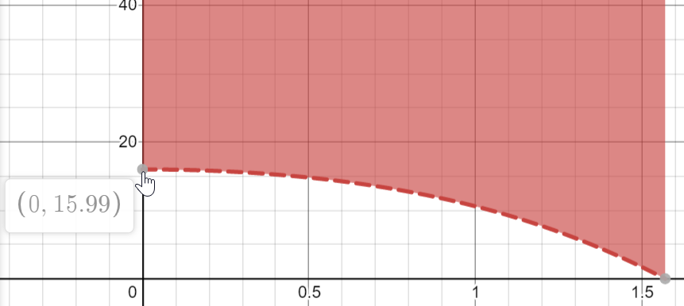
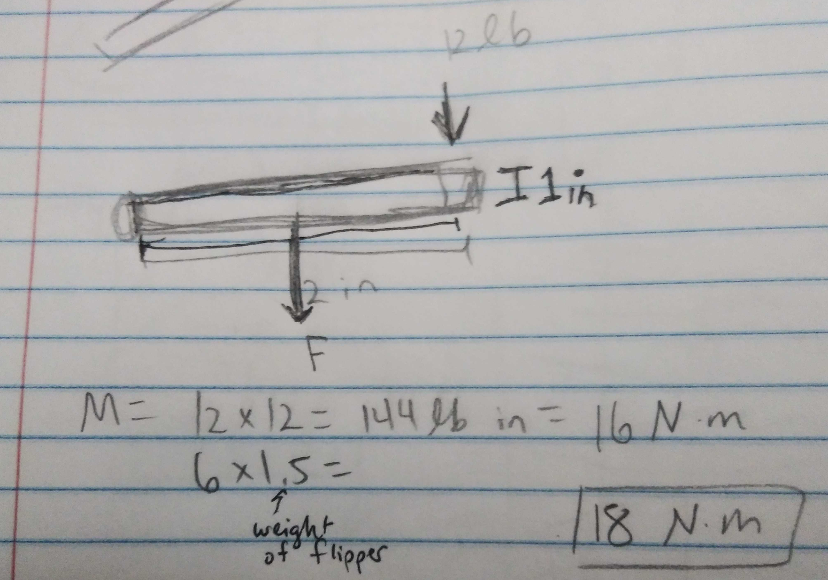
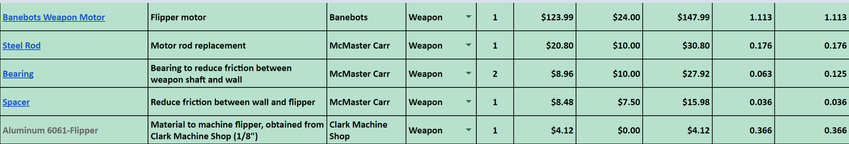
Weapon
Subsystems
Motor Calculations
To flip ourselves over - Graph of torque required throughout process (to 90 deg) - max 16Nm
To lift other robots - max 18Nm
Motor torque (as listed) = 67Nm
Design Decisions
No flexible shaft coupling - replaced with steel rod
½” wide flipper-stability, allows for thinner flipper end
No aluminum support for flipper (flipper now aluminum)
Weight = ~2lb
Price: $226.81

Slide 12
Concerns
Sportsman Mechanical CDR
Foam
may get torn up quickly, especially with saws
may not do much for impact, not hard enough
Weight
only about .5 lb wiggle room
3mm axles on drive motors and wheels
thin diameter, may break

Slide 13
Next Steps
Sportsman Mechanical CDR
Part Drawings
Meeting with Kinetic to go over all decisions and parts
Adding Final Screws in CAD
Manufacturing Plan
Meetings over winter break
Jan Fab

Slide 14
Thank you!
Questions?

